Slide 1
Question’s posed to panel
What steps do you take to safeguard the purity of your crop/seed production?
What steps do you take to safeguard the purity of your neighbors’ crops?
What policies as a company/organization do you have in place to ensure the quality of products derived from your seed?
What policies do you mandate/encourage farmers to use to limit pollen movement off of their fields?

Slide 2
What I will cover in 10-15 minutes
Who is Cal/West Seeds?
Answer each of the 4 questions
Who is the National Alfalfa Forage Alliance (NAFA)?
What are Grower Opportunity Zones for GE and for AP-Sensitive alfalfa seed production?

Slide 3
Who is Cal/West Seeds?
CWS is a California cooperative owned by forage seed producers in the Western U.S.
Owners residing in defined production regions elect representatives to serve on the cooperative’s board of directors.
A team of experienced, professional seedsmen oversee the day-to-day operations of the business and manage the company.

Slide 4
Who is Cal/West Seeds?
CWS formed in 1969 merger of two existing California based seed cooperatives: California Ladino Clover Association, founded in 1939 and Calapproved, founded in 1950.
CWS initiated a comprehensive research program during the 1970’s focused on improved alfalfa varieties to major hay production areas found in the USA, Argentina, Canada, Mexico, France, Australia, and Saudi Arabia.
CWS conducts business in over 30 countries.

Slide 5
Who is Cal/West Seeds?
CWS goal increase “Value Through Innovation.”
Aggressive, cutting edge breeding programs focused on developing varieties having the genetic potential to maximize farm profitability.
CWS current investment in biotechnology is focused on developing innovative varieties with enhancements to seed yield, forage yield, forage quality, pest resistance, and stress tolerance.

Slide 6
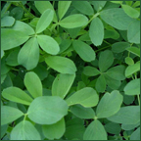
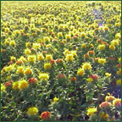
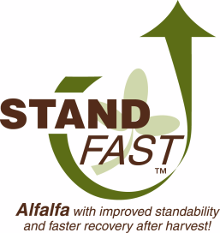
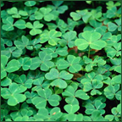
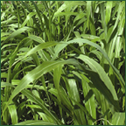
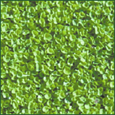
Crops include:
Alfalfa
Safflower
Clover
Sudangrass
Dichondra
Alfalfa
Safflower
Clover
Sudangrass
Dichondra

Slide 7
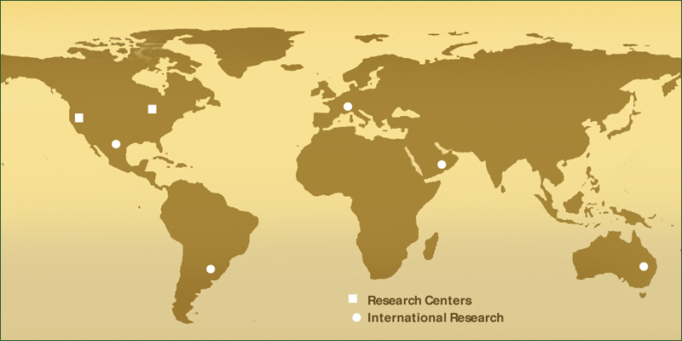
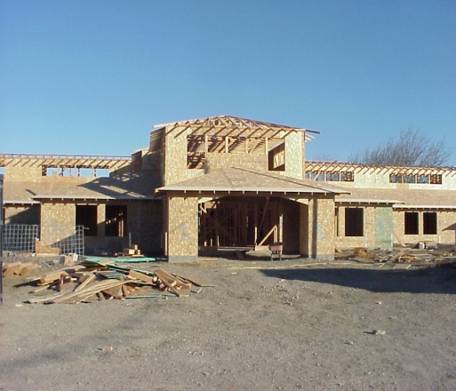
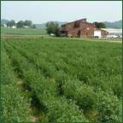
Cal/West operates US research facilities in California and Wisconsin, augmented by satellite testing and selection sites around the globe.
Woodland research facility
Wisconsin research facility
Currently constructing combined corporate office and research facility on 70 acres between Woodland and Davis. Expected completion date is June 2007
Center for Bio-tech activities and breeding for winter hardy alfalfas. Also serves as office for US and Canadian licensing activities

Slide 8
Cal/West Seeds Seed Multiplication Standards (Federal Seed Act Section 201.76 / AOSCA)
Syn.1, Syn.2, Syn.3
Breeder Seed: seed (or vegetative propagating material) increased by the originating or sponsoring, plant breeder or institution, used as the source for the increase of Foundation Seed and is the source of Certified seed, either directly or through Foundation and/or Registered seed.
Syn.2, Syn.3, Syn.4
Foundation Seed: seed stocks increased from Breeder seed, and so handled as to closely maintain the genetic identity and purity of a variety. Foundation seed is the source of Certified seed, either directly or through Registered seed.
Syn.3, Syn.4, Syn.5
Registered Seed: the progeny of Breeder or Foundation Seed and so handled as to closely maintain the genetic identity and purity of the variety. Registered seed is the source of Certified seed. Registered seed must be approved and certified by an official seed certification agency.
Syn.4, Syn.5, Syn.6
Certified Seed: the progeny of Breeder, Foundation, or Registered Seed, produced and so handled as to closely maintain genetic purity or identity of a variety. Certified seed is approved and certified by an official seed certification agency.

Slide 10
What steps do you take to safeguard the purity of your crop/seed production?
Breeder seed is produced under cage to prevent any foreign pollen from pollinating the parental plants. Breeder seed is checked for the presence of the RRA trait.
Foundation seed is planted in accordance with Foundation Seed Standards relating to field history and isolation. Since the introduction of RRA, we are taking extraordinary steps to plant our foundation seed fields in isolated areas where no RRA seed or hay is known to exist. Foundation seed is checked for the presence of the RRA trait.
Commercial seed is produced on the basis of an “end-use” classification. Seed destined for GE sensitive markets is produced in accordance with NAFA Best Management Practices for AP sensitive seed. www.alfalfa.org/pdf/BMPforAPS.pdf. Commercial seed is checked for the presence of the RRA trait.

Slide 11
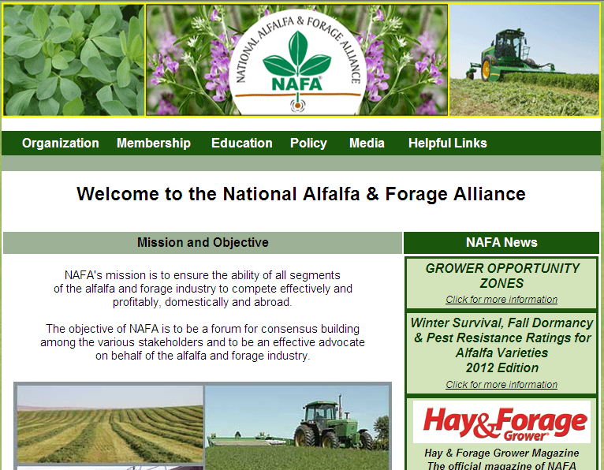
Who is the National Alfalfa & Forage Alliance (NAFA)?

Slide 12
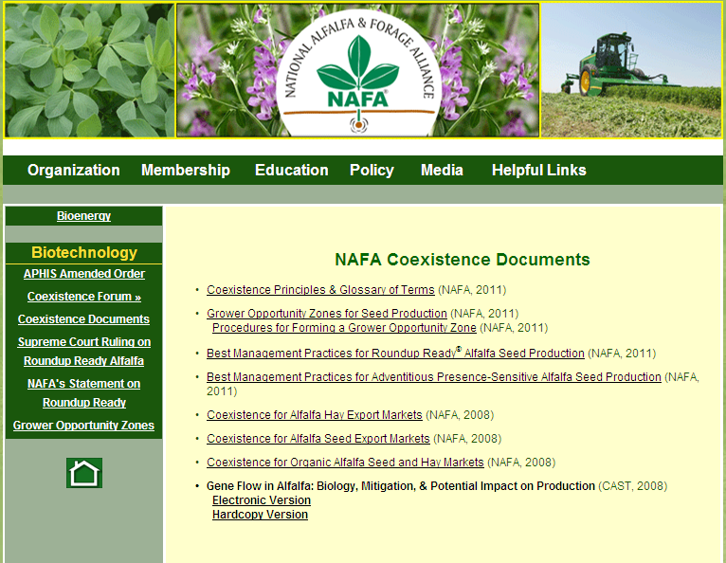

Slide 13
What steps do you take to safeguard the purity of your neighbors’ crops?
We are not currently producing GE alfalfa seed. We follow certification standards pertaining to isolation to ensure that we have sufficient distance to maintain the genetic purity of our crop, which in turn protects the neighbor’s crops.
We are using the national pinning map in conjunction with the Seed Certification standards to position fields, in relation to GE seed production fields, to ensure that our seed meets purity standards.
In addition to the pinning map the alfalfa industry through NAFA has Grower Opportunity Zones (GOZs) for both GE and AP Sensitive seed production. www.alfalfa.org/pdf/ProceduresFormGOZ.pdf
In the case of alfalfa, the grower opportunity zone concept has merit, but falls short of adequately addressing the potential for low level presence of a GE trait that could result from GE alfalfa hay fields in proximity to the seed production fields.
This issue concerns the production of seed for APS markets in areas where hay production is also occurring.

Slide 14
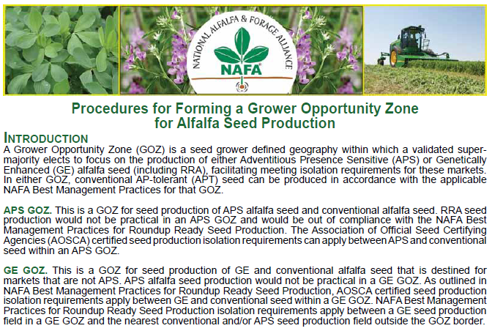

Slide 15
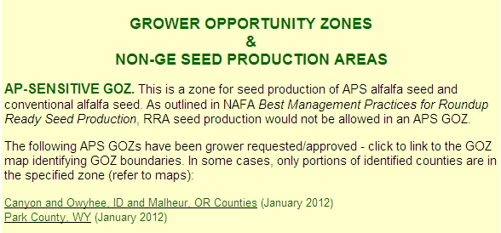
NAFA Grower Opportunity Zones

Slide 16
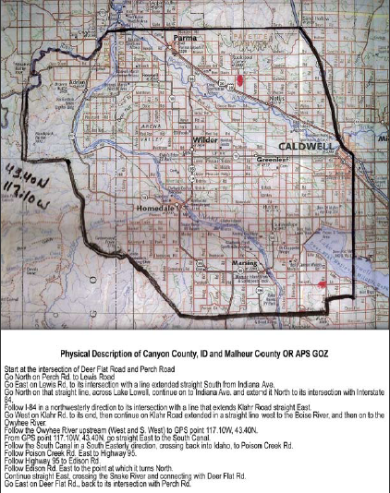
NAFA – APS GOZ in OR/ID

Slide 17
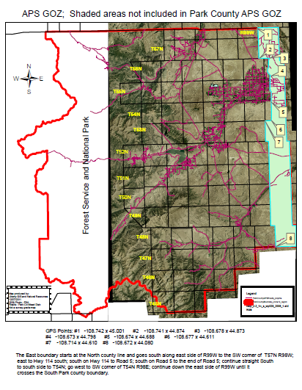
NAFA - APS GOZ in WY

Slide 18
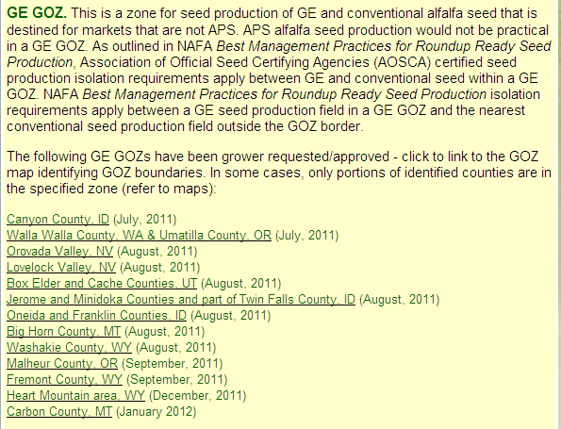
NAFA – GE GOZs

Slide 19
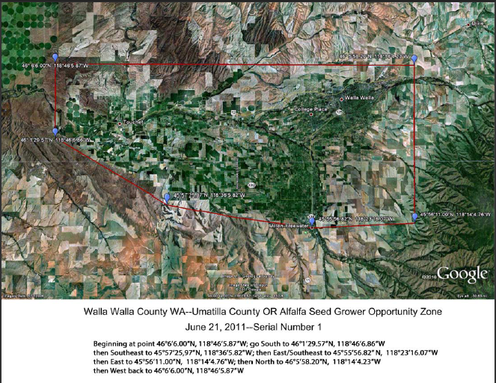
NAFA - GE GOZ in WA

Slide 20
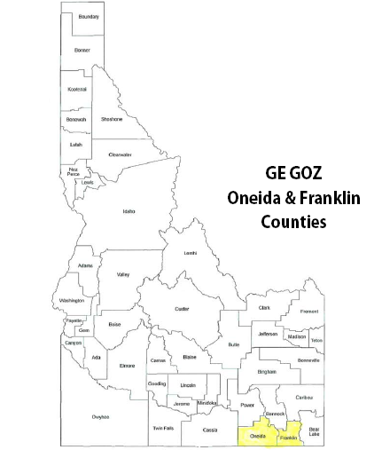
NAFA - GE GOZs

Slide 21
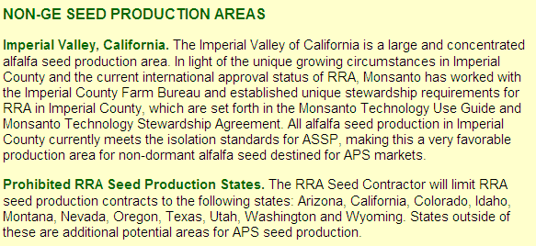
NAFA Grower Opportunity Zones

Slide 22
What policies as a company/organization do you have in place to ensure the quality of products derived from your seed?
In addition to following the NAFA Best Management Practices we have an internal policy and procedure relating to Biotechnology traits that provides additional measures to assure our seed purity meets standards.
As it relates to research, we are recognized under the BQMS program designed to assure that biotech traits are contained and well managed so that the genetic purity of our non GMO lines is maintained. http://www.aphis.usda.gov/biotechnology/downloads/BQMS/List_BQMS_Participating_Organizations.pdf

Slide 23
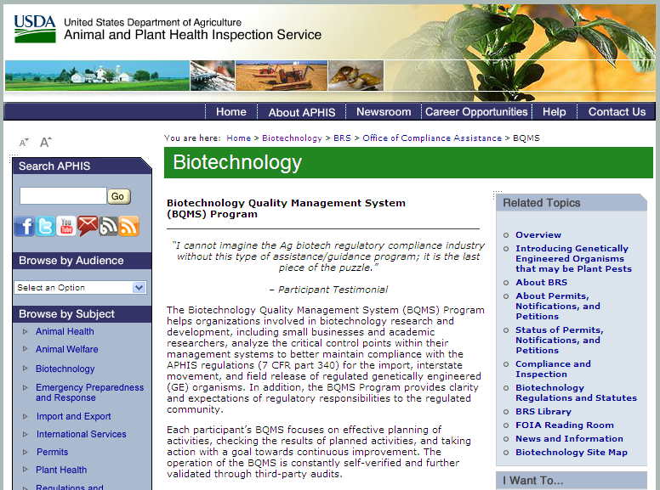

Slide 24
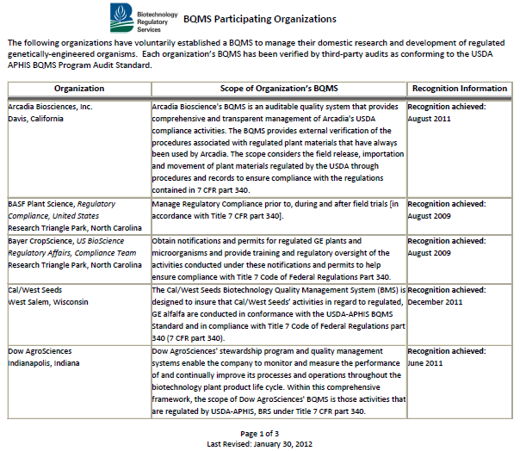

Slide 25
Quality Manual

Slide 26
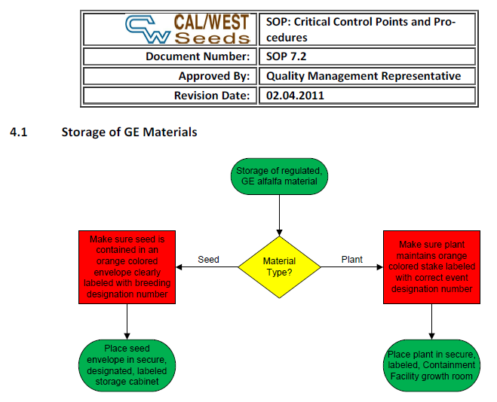
Example CWS USDA-BQMS SOP

Slide 27
What policies do you mandate/encourage farmers to use to limit pollen movement off of their fields?
This is not an issue for CWS as currently we are not producing GE seed.
Standard isolation practices help minimize pollen/gene movement.
That said there are no practical limits to pollen movement in an insect pollinated crop with both managed and native/feral pollinators.
Significant isolation distances provide the best safeguard.
The NAFA Best Management Practices for RR alfalfa seed production documents the requirements to limit the potential for gene transfer. Adherence to these requirements is not something our company can attest to. www.alfalfa.org/pdf/ProceduresFormGOZ.pdf

